Slide 1
Project Title
Face Mask Detection
Presented By
Rohit Samarth
Aakib Sayyad
Ritik Pusdekar
Mohit Zade
Tejas Ubale
Under the Guidance of
Prof N.A. Pande

Slide 2
Content
Introduction
Problem Definition
Literature Review
Tools Required
Methodology
Result
References

Slide 3
Introduction
According to the World Health Organization (WHO)’s official Situation Report – 205, coronavirus disease 2019 (COVID-19) has globally infected over 20 million people causing over 0.7million deaths [1]. Individuals with COVID19 have had a wide scope of symptoms reported – going from mellow manifestations to serious illness. Respiratory problems like shortness of breath or difficulty in breathing is one of them. Elder people having lung disease can possess serious complications from COVID-19 illness as they appear to be at higher risk.
To curb certain respiratory viral ailments, including COVID-19, wearing a clinical mask is very necessary. The public should be aware of whether to put on the maskfor source control or aversion of COVID-19. Potential points of interest of the utilization of masks lie in reducing vulnerability of risk from a noxious individual during the “pre-symptomatic” period and stigmatization of discrete persons putting on masks to restraint the spread of virus. WHO stresses on prioritizing medical masks and respirators for health care assistants. Therefore, face mask detection has become a crucial task in present global society.

Slide 4
Problem Definition
COVID-19 pandemic has rapidly affected our dayto-day life disrupting the world trade and movements. Wearing a protective face mask has become a new normal. In the near future, many public service providers will ask the customers to wear masks correctly to avail of their services.
Therefore, face mask detection has become a crucial task to help global society.
Our Goal is to propose a model through which we can determine if a person wearing the mask or not. We aim to increase the accuracy of the model and provide assistance.

Slide 5
Literature Review
Sr.no | Title | Authors | Year | Description
1. | Covid-19 Face Mask Detection Using TensorFlow, Keras and OpenCV | Arjya Das,Mohammad Wasif Ansari,Rohini Basak | 2020 | This paper presents a simplified approach to achieve this purpose using Machine Learning packages like TensorFlow, Keras, OpenCV and Scikit-Learn. The proposed method detects the face from the image correctly and then identifies if it has a mask on it or not. As a surveillance task performer, it can also detect a face along with a mask in motion.

Slide 6
Sr.no | Title | Authors | Year | Description
2 | An Approach to Face Detection and Recognition | Divya Meena,Ravi Sharan | 2016 | Face detection has attracted immense attention because it has many applications in computer vision communication and automatic control system.Research into face detection, expression recognition, face tracking, pose estimation is required. By giving a single image, challenge is to detect the face from that image. Face detection is a challenging task because faces are not rigid and it changes in size, shape, color etc. In this paper, viola Jones algorithm is used to detect face and principal component analysis for face recognition

Slide 7
Sr.no | Title | Authors | Year | Description
3. | Face Mask Detection Using OpenCV | Harish Adusumalli ,D Kalyani | 2021 | The COVID-19 pandemic is causing a worldwide emergency in healthcare. This virus mainly spreads through droplets which emerge from a person infected with coronavirus and poses a risk to others. The risk of transmission is highest in public places. One of the best ways to stay safe from getting infected is wearing a face mask in open territories as indicated by the World Health Organization (WHO). In this project, we propose a method which employs TensorFlow and OpenCV to detect face masks on people. A bounding box drawn over the face of the person describes weather the person is wearing a mask or not.

Slide 8
Sr.no | Title | Authors | Year | Description
4 | Advice on the use of masks in the context of COVID-19 | WHO | 2020 | This document provides advice on the use of masks in communities, during home care, and in health care settings in areas that have reported cases of COVID-19. It is intended for individuals in the community, public health and infection prevention and control (IPC) professionals, health care managers, health care workers (HCWs), and community health workers.

Slide 9
Tools Used
TensorFlow: TensorFlow, an interface for expressing machine learning algorithms, is utilized for implementing ML systems into fabrication over a bunch of areas of computer science, including sentiment analysis, voice recognition, geographic information extraction, computer vision, text summarization, information retrieval, computational drug discovery and flaw detection to pursue research . In the proposed model, the whole Sequential CNN architecture (consists of several layers) uses TensorFlow at backend. It is also used to reshape the data (image) in the data processing.
Keras: Keras gives fundamental reflections and building units for creation and transportation of ML arrangements with high iteration velocity. It takes full advantage of the scalability and cross-platform capabilities of TensorFlow. The core data structures of Keras are layers and models. All the layers used in the CNN model are implemented using Keras. Along with the conversion of the class vector to the binary class matrix in data processing, it helps to compile the overall model.

Slide 10
OpenCV: OpenCV (Open Source Computer Vision Library), an opensource computer vision and ML software library, is utilized to differentiate and recognize faces, recognize objects, group movements in recordings, trace progressive modules, follow eye gesture, track camera actions, expel red eyes from pictures taken utilizing flash, find comparative pictures from an image database, perceive landscape and set up markers to overlay it with increased reality and so forth . The proposed method makes use of these features of OpenCV in resizing and color conversion of data images

Slide 11
Methodology
Pre Processing
Classification
Input of Dataset
Training Model
Output

Slide 12
Methodology(cont..)
An Open Source dataset containing 100’s of masked and unmasked images are acquired.
This dataset is entered in the model through input layer of the proposed model.
This dataset is further processed and analysed for model compatibility.
The dataset undergoes multiple stages inorder to make the dataset usable.
Dataset is divided into train and test group. The training dataset is used to test the model while the test group is used to test the performance of the model.
This images is the further used to train the proposed model.
The accuracy and other performance matrix is used to analysis the performance of the proposed model.
After the model is trained, it used to classify the the images to classify into masked and unmasked images.

Slide 13
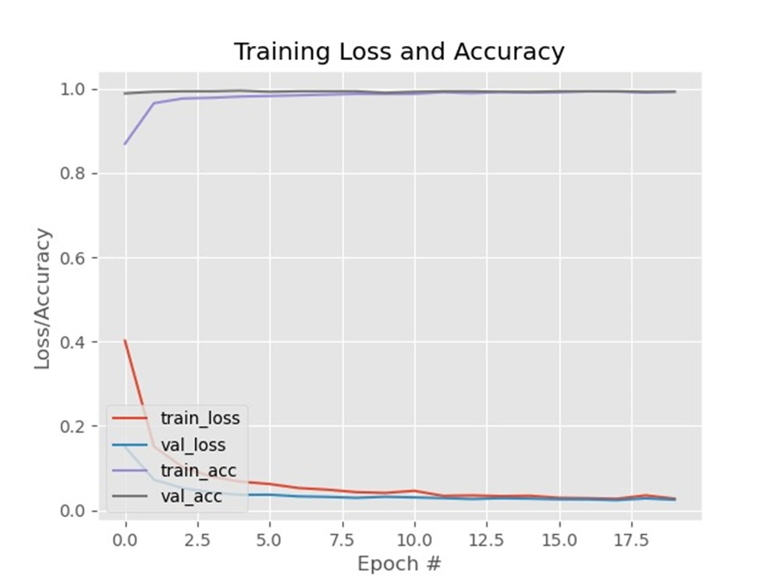
Result
Training Loss and Accuracy:-

Slide 14
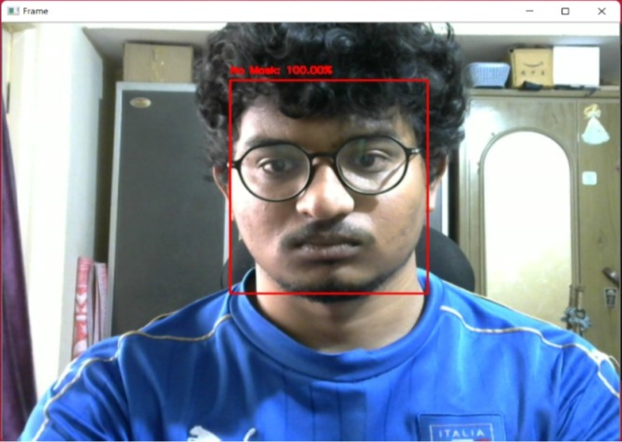
Result
Without Mask:-

Slide 15
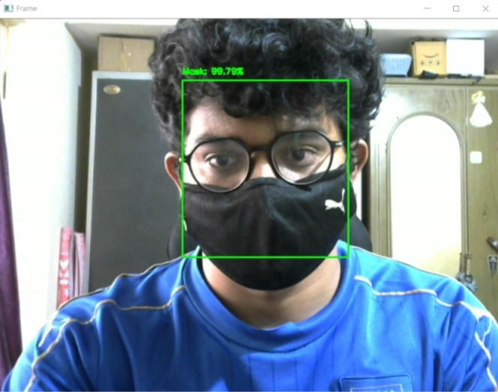
Result
With Mask:-

Slide 16
References
[1] Covid-19 Face Mask Detection Using TensorFlow, Keras and OpenCv, Arjya Das,Mohammad Wasif Ansari,Rohini Basak, 2020
[2] An Approach to Face Detection and Recognition, Divya Meena,Ravi Sharan,2016
[3] Face Mask Detection Using OpenCV, Harish Adusumalli ,D Kalyani, 2021
[4] Advice on the use of masks in the context of COVID-19, WHO, 2020

